Slide 1

Full-text search

Slide 2

Apache Lucene

Slide 3

Elasticsearch
Keywords:
Index
Shards
Analyzer
Tokenizer (N-gram, Edge N-gram, standard)
Mapping
download: https://www.elastic.co/downloads/elasticsearch

Slide 4
Elasticsearch
Tokenizer (N-gram, Edge N-gram, standard)

Slide 5
Elasticsearch
Analyzer vs Search analyzer

Slide 6

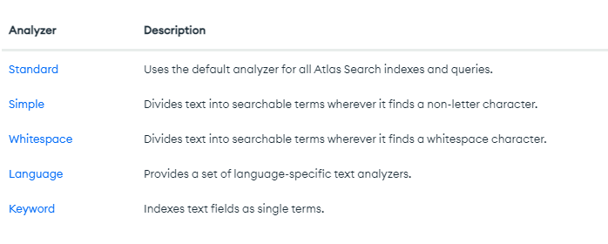

Slide 7
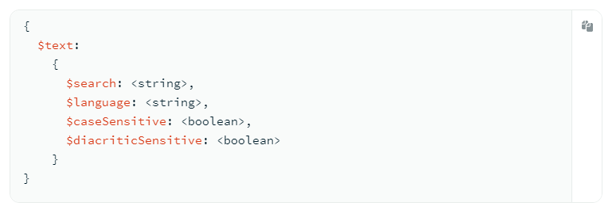

Slide 8

Tsvector
Tsquery
to_tsvector
to_tsquery (plainto_tsquery, phraseto_tsquery, websearch_to_tsquery)
ts_rank (ts_rank_cd)

Slide 9
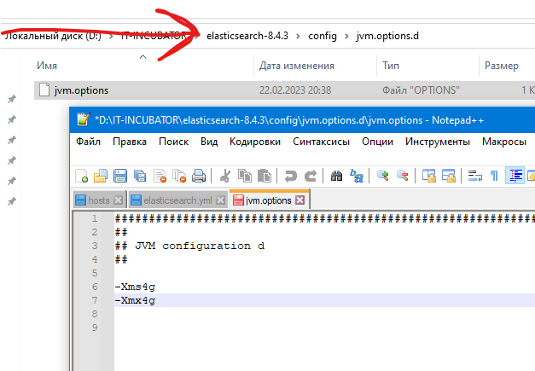
JVM-env-settings
max memory size JVM

Slide 10
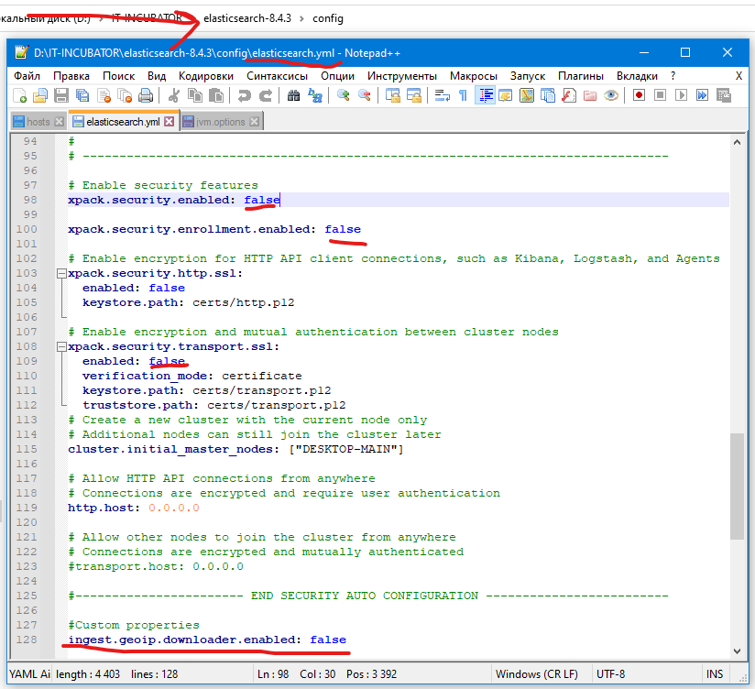
Elastic-env-settings
auth

Slide 11
Материалы
https://lucene.apache.org/core/9_5_0/index.html
https://www.elastic.co/guide/index.html
https://www.mongodb.com/docs/manual/text-search/
https://www.postgresql.org/docs/10/textsearch.html
https://habr.com/ru/post/174457/
https://habr.com/ru/company/likeastore/blog/223109/ переходим от монго к еластик
https://albinjose.medium.com/full-text-search-in-mongodb-using-mongoose-b4154bc3a41b
https://habr.com/ru/post/442170/ опыт полнотекстового поиска postgres
https://codedzen.ru/category/uroki/elasticsearch/

